Slide 1
Assembly and Mercantile Occupancies
Determine what differentiates this type of occupancy from others
Identify the key provisions that are different from the general chapters

Slide 2
Historic Fire
L'Innovation Department Store

Slide 3
People
Types of people present
  Familiarity
  Abilities
Activities

Slide 4
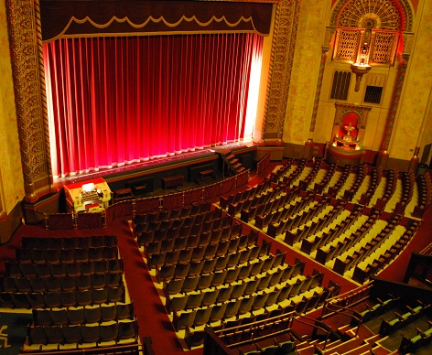
Occupancy Classifications- Assembly
A-1 Theaters with fixed seating
A-2 Food and drink
A-3 Worship, recreation, amusement, and general
A-4 Indoor sporting events
A-5 Outdoor sporting events

Slide 5
Life Safety Evaluation
Occupant load exceeds 6000 persons
AHJ must approve of plan
  Annual review of written report
10 criteria:
  Nature of event • Access and egress
  Medical emergencies • Fire hazards
  Structural systems • Severe weather
  Earthquakes • Civil disturbances
  Haz mat incidences • Stakeholder relations

Slide 6
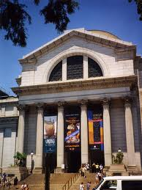
Main Entrance/Exit
Required consideration of assembly occupancies
At level of discharge
  Stair down is fine
Accommodate 50% of the population in most buildings
  67% in dance halls, discotheques, nightclubs, occupancies with festival seating
Other exits 50%
  As far away as practical

Slide 7
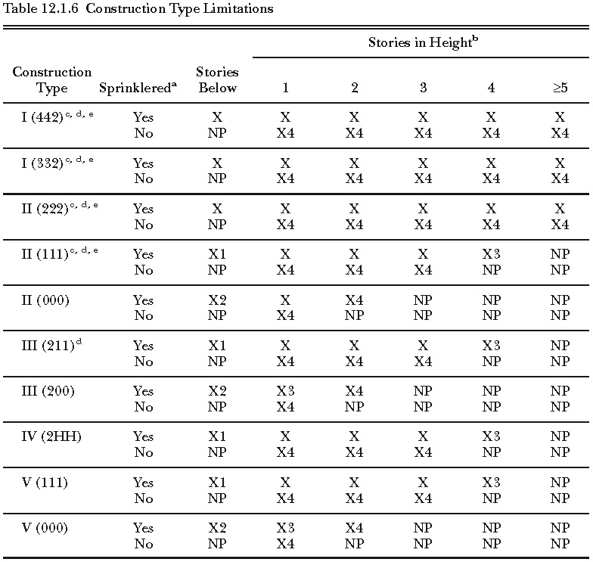
Construction Type
Will depend on height

Slide 8
Means of Egress
Typically Chapter 7
No turnstiles in means of egress
  Most often in places of assembly
  Options:
    Gate
    Fold recessed
44 in wide corridors if >50 people
Seating at tables
  Aisle
  Aisle access
Approval of layouts

Slide 9
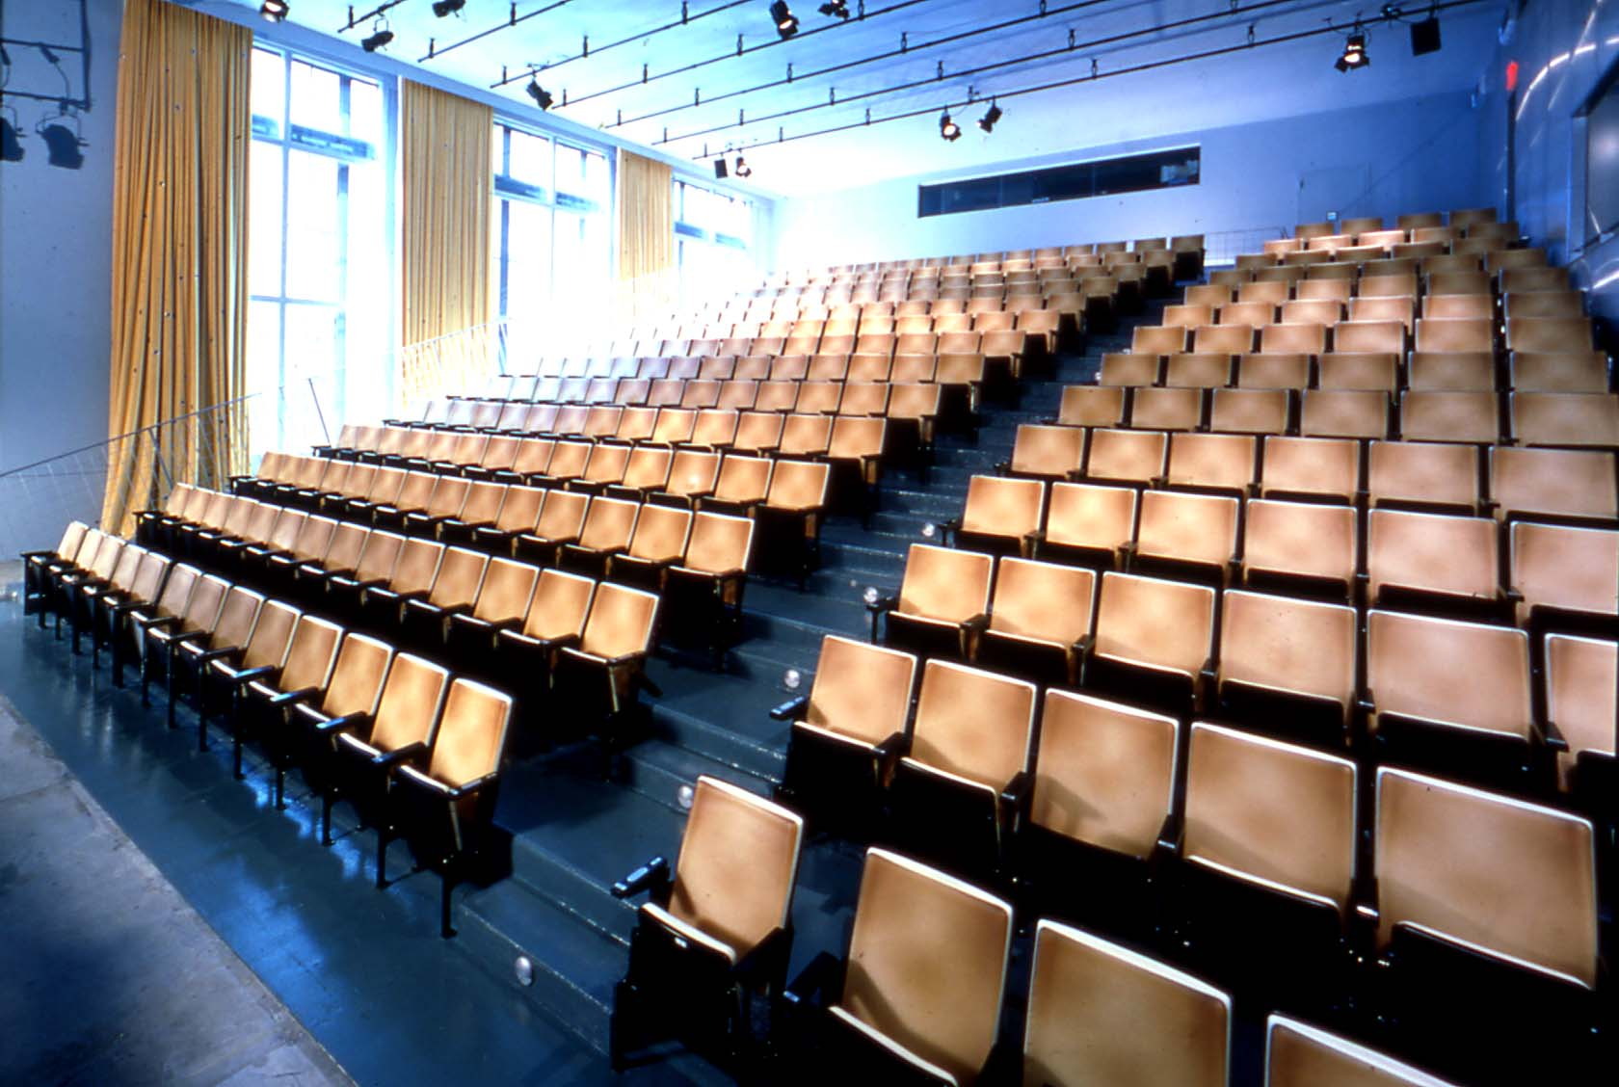
Theater Seating
Stairs: 0.3*A*B in/seat
  If riser height >7in: A=1+(R-7)/5
  If handrail > 30 in away: B=1.25
Passageways, doors, ramps: 0.22*C in/seat
  If ramp slope > 1 in 10: C=1.10
Aisle access width between seats: 12 in to 22 in
100 seats/row

Slide 10
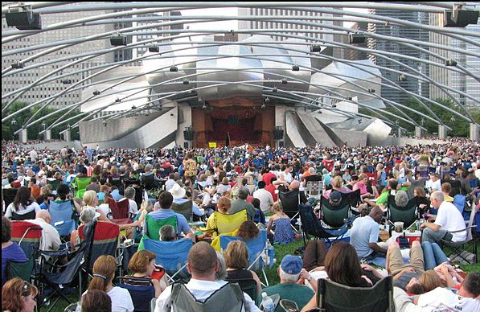
Auditoriums and Arenas
Seating
Floor area
  50 % not exit through seating
Festival seating
  250 people
  Maintained egress routes
Waiting spaces

Slide 11
Management and Systems
Crowd managers
  Mass movement of people
  Staff assigned just to keep order
  1 for every 250 people
Drills
  Must be held to train
  Employees taught to use extinguishers
Rules typically based on size
  300 persons
Alarms
  Constantly monitored
  Visual and audible
  Voice
CO detection
Sprinklers
Risk analysis

Slide 12
Special Provisions
Smoke-protected seating
  Smaller egress components for large populations
Limited access or underground buildings
  Smoke
Stages and platforms
  Fire load
Projection rooms
  Fire load
Special amusement buildings
  Life safety
Grandstands
  Fire load
  Life safety
Folding and telescopic seating
Airport loading walkways
  From planes

Slide 13
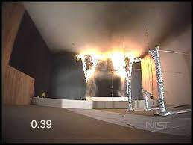

Open Flames
Cooking
  Open flames
Pyrotechnics
  Typically not allowed

Slide 14
Mercantile Classifications
Class A
  30,000 ft² gross
  4+ stories for sales
Class B
  3000 ft² gross
  2 or 3 stories for sales
Class C
  Small
  One story
Do not count nonpublic areas
Hazard level in accordance with 6.2
  Restrictions for high hazard
Street floor classification can apply to multiple floors

Slide 15
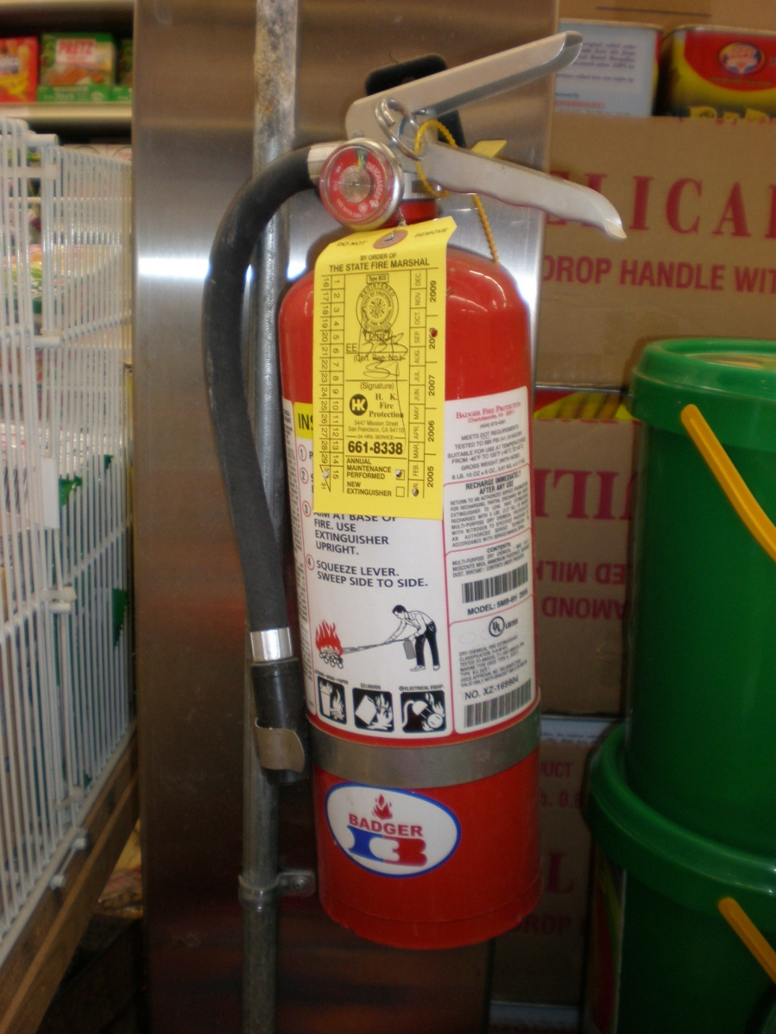
Fire Protection Systems
Different depending on classification
Fire alarm in Class A
Sprinklers in Class A
  Some Class B
Portable extinguishers

Slide 16
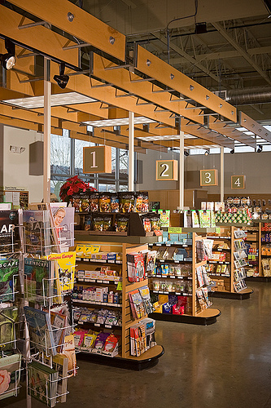
Means of Egress
Larger aisle in Class A
Limited exiting through check-out stands
Limited exiting through other walls if only entrances on one wall
Can exit through storeroom

Slide 17
Gross Leasable Area
Anchor Store
Anchor Store
Anchor Store
Anchor Store

Slide 18
Malls
Major Tenant
  ½ required width independent of mall
Non-occupied areas directly to exits
Must have fire alarm
  Activates with sprinklers
Alarm or voice must sound throughout
  No visual requirement
Smoke control
Sprinklers throughout
Risk Analysis
Mall can be considered a pedestrian way
  20 ft wide
  Exit width minimum 66 in
  Fully sprinklered
  Dead-end twice width of mall
  Additional 200 ft travel distance allowed
Limitations on signs
Kiosks

Slide 19
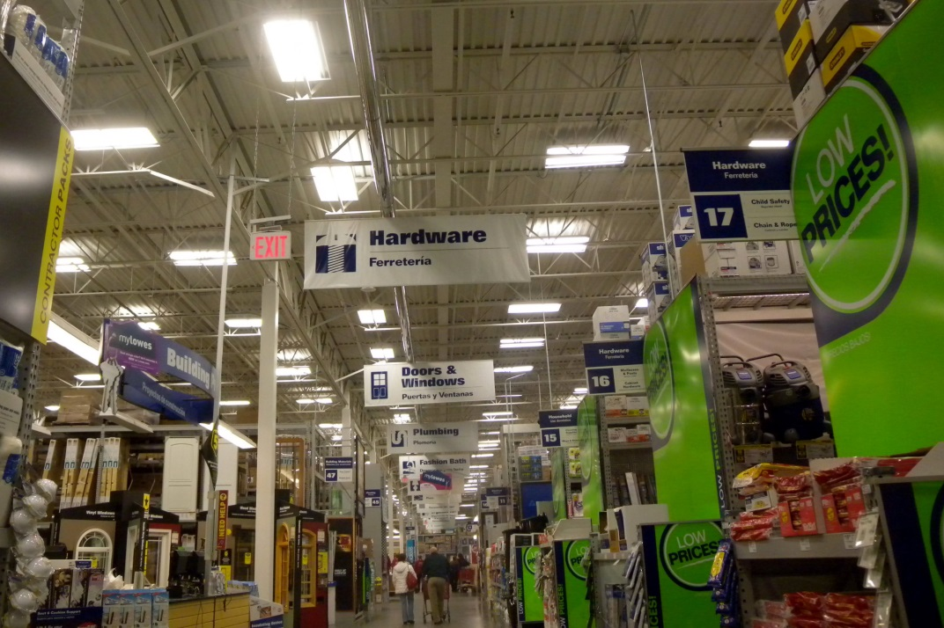
Bulk Merchandising
16 ft ceiling
Fire alarm
  Initiated by sprinklers
Emergency Action Plan

